Slide 1
Introduction to LangChain
Pascal Simon
2024/11

Slide 2

Agenda
What is LangChain and why do we need it?
Key components of LangChain
Examples with code

Slide 3
Applications using LLMs face specific challenges that are not present in traditional applications, such as fragility, non-determinism and fuzzy data
LangChain is a rapidly evolving powerful software library for Python that helps building LLM-powered applications
Key abstractions offered by LangChain are Chains, Agents and VectorStores. These allow for concise code using the LCEL expression language
Implementations of simple chain and agent-based example applications will be shown, as well as a more complex RAG example

Slide 4

What is langchain and why do we need it?
< 1 >

Slide 5
Defining terms: what is an LLM?
LLM = large language model, is a machine learning model able to output natural language text based on natural language input
Or simplified:
Calculate embeddings
Text
Vectors of floats
Model
Predicts
Next token
lookup
Text
Prompt
LLM
Answer

Slide 6
Traditional ML model vs. LLM
‘Traditional’ machine learning model
Number of parameters to train in the order of 1000’s to millions
Models need to be trained from scratch input-features are specific to problem
GPU beneficial for efficient training.
Inference is very fast, no special hardware required.
Large language model (LLM)
Number of parameters in the billions (e.g. Llama2->80 b, GPT4 supposedly > 1 trillion)
Models are pre-trained, can be applied to many problems without any fine-tuning
Multiple servers required for training
Inference also requires GPU with lots of memory, and is still slow

Slide 7
Three categories of applications
Traditional application
Machine learning
Training Usage
(Agentic) LLM application
User
Data
User
User
App Logic
Training
App Logic
LLM App
Model
Data
Model
Model
App Logic
deploy
static
dynamic

Slide 8
Categorizing LLM applications ¹⁾
Code Assistance
Code generation & completion
Debugging & refactoring
Documentation generation
RAG
Q&A on docs / knowledge systems
Customer support bots
Analysis & Insights
Data cleansing & annotation
Exploratory data analysis
Decision Support
Strategy recommendations
Scenario-based simulations ²⁾
Conversational AI
Chat-based customer service
Personal productivity, e.g. task scheduling bot
Language Services
Translation
Text-to-speech / speech-to-text
Linear, pre-defined workflow
Dynamic workflow
Gaming & Entertainment
NPC dialog
Generating quests
Educational & Training
Language learning
Personalized tutoring
Content Generation
Blog posts, newsletters
Illustrations
Personalization & Recommendation
Personalized travel itineraries
User-specific product recommendation
1) Generated with ChatGPT, edited
2) https://arxiv.org/html/2407.06486v1

Slide 9
Challenges when coding with LLMs
Input & Output is natural language text -> fuzzy
Non-deterministic output
LLMs are slow
Every call costs money -> can be expensive to experiment
Fragile (token limits, API responsiveness, model lifecycle)
Quantitative evaluation is difficult (what is correct, what is wrong?)
Therefore: unit-tests are difficult

Slide 10
Challenges illustrated
Traditional application code
LLM application code
def square_number(input :int) -> int:
return input * input
def answer_question(input :str) -> str:
return llm.process(input)
Deterministic (same input -> same output)
Fast (microseconds)
Easy to unit-test
e.q. square_number(3) must be 9
Robust (will always work)
Non-Deterministic (can’t predict output)
Slow (seconds)
Difficult to unit-test
E.g. answer_question(“what is an llm?”) must return what exactly?
Fragile (depending on load the model might be slower or even unavailable)

Slide 11
LangChain addresses these challenges
LangChain is a programming framework with Python and JavaScript bindings
Aims to accelerate and simplify building applications based on LLMs
Started in Oct 22 by Harrison Chase ¹⁾
Incorporated as in April 23, raised $20M, valued at $200M ¹⁾
LangChain framework remains open source, > 4K contributors
Seems to be the de-facto standard for building LLM-based applications
Integrates with a large number of LLMs and other services typically required (vector stores, document processing, evaluation, etc.)
1) https://en.wikipedia.org/wiki/LangChain

Slide 12
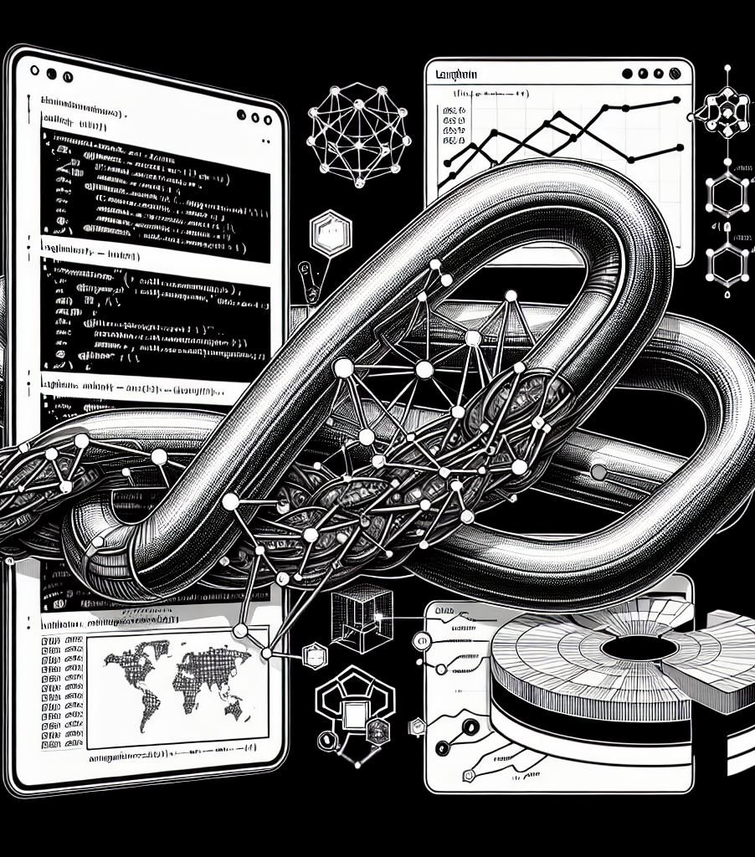
Key components of LangChain
<2>

Slide 13
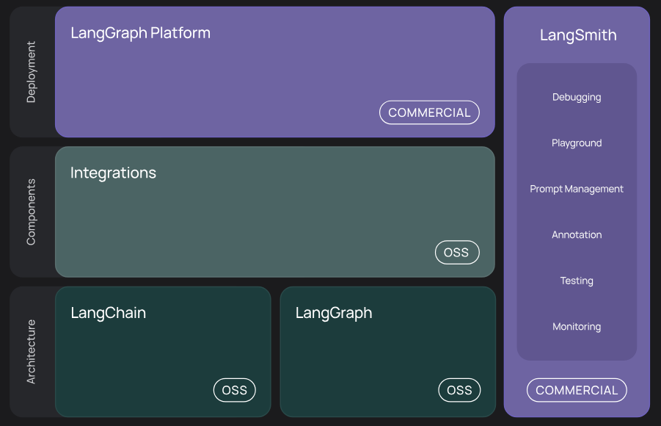
LangChain, LangSmith, LangGraph
LangChain: the actual programming framework
Integrations: 3rd party adapters
LangGraph: High-level framework to work with agents
LangSmith: Platform monitoring & evaluation
Source: https://python.langchain.com/docs/introduction/

Slide 14
What the chain in LangChain means
Initially, LLM applications were typically seen as a chain of processes
LangChain introduces an expression language LCEL that allows elegant chain definition
Example: Q&A on company knowledge database (using RAG) ¹⁾
User input
Embedding
Retrieval
Prompt
LLM call
Output Formatting
rag_chain = ( {"context": retriever | format_docs,
"question": RunnablePassthrough() } | prompt | llm | StrOutputParser() ) rag_chain.invoke("What is LangChain?")
1) https://python.langchain.com/docs/tutorials/rag/

Slide 15
Retrievers, vector-stores & memory
If the application should work with a specific data source (like company knowledge), a data store is needed, specifically a vector-store
Memory is used to store the state of a conversation
Retrievers connect a vector-store to chains and agents
For example:
FAISS: Easy to use in-memory vector store
BM25Retriever: Full text search using BM25 algorithm
LOTR: Lord of the retrievers: combines multiple retrievers

Slide 16
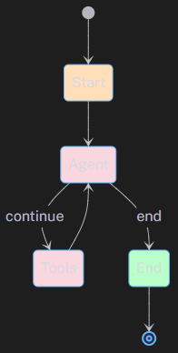
When a chain is too static, we use agents
Chains are similar to traditional software: pre-defined workflow
Agents use LLMs to determine what to do
In each step, Agents can use Tools
Traditional agents follow the REACT pattern: REason-ACT
Human intervention possible (sometimes recommended, e.g. if you build an investment bot)
1)
Start
Agent
Tool
End
1) https://langchain-ai.github.io/langgraph/reference/prebuilt/#langgraph.prebuilt.chat_agent_executor.create_react_agent

Slide 17
An agent is nothing without a tool
Tools are used to integrate virtually any functionality. E.g.:
Shell: allows running shell commands
TavilySearchResults: Web-search
WikipediaQueryRun: Search Wikipedia
YouTubeSearchTool: Search youtube videos, incl. metadata and transcriptions
BearlyInterpreterTool / PythonREPL: Runs code
WolframAlphaAPIWrapper: Solves complex math
Toolkits are collections of tools (E.g. SqlDatabaseToolkit)

Slide 18
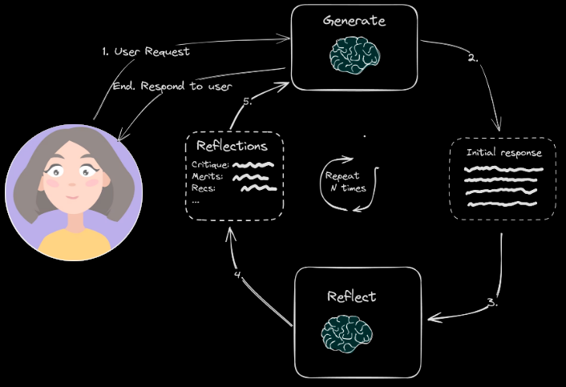
When one agent is not enough: LangGraph
LangGraph takes the REACT pattern to the next level
Multiple agents can work together
Agents reflect on the success of their actions
Agents store Reflections and take them in to account in following steps
LangChain offers also a platform called LangGraph to deploy applications
1)
https://langchain-ai.github.io/langgraphjs/tutorials/reflection/reflection
General intro: https://langchain-ai.github.io/langgraph/concepts/high_level/#core-principles

Slide 19
Integrating 3rd party APIs
The main strength of LangChain is the availability of 3rd party Models, Stores, Retrievers, Agents, Tools, Toolkits, etc.
Examples for LLMs are:
OpenAI
Anthropic
HuggingFace
Mistral
Google
There also things like a wrapper that allows using Sql Server as VectorStore

Slide 20
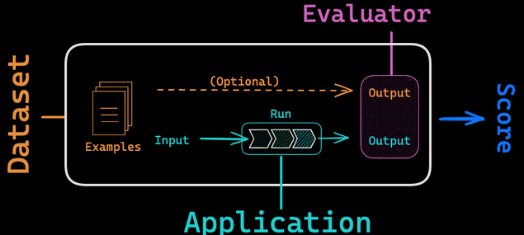
Evaluation with LangSmith
LangSmith is a commercial platform offered by LangChain
It allows monitoring and evaluating LLM based applications
1)
1) https://docs.smith.langchain.com/evaluation/concepts

Slide 21
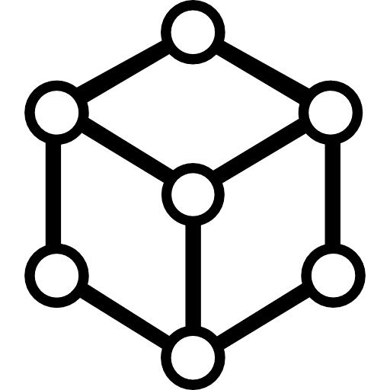






Summary of components
Models
Tools
LangSmith
Chains
Agents
Retrievers &
Stores
LangGraph

Slide 22
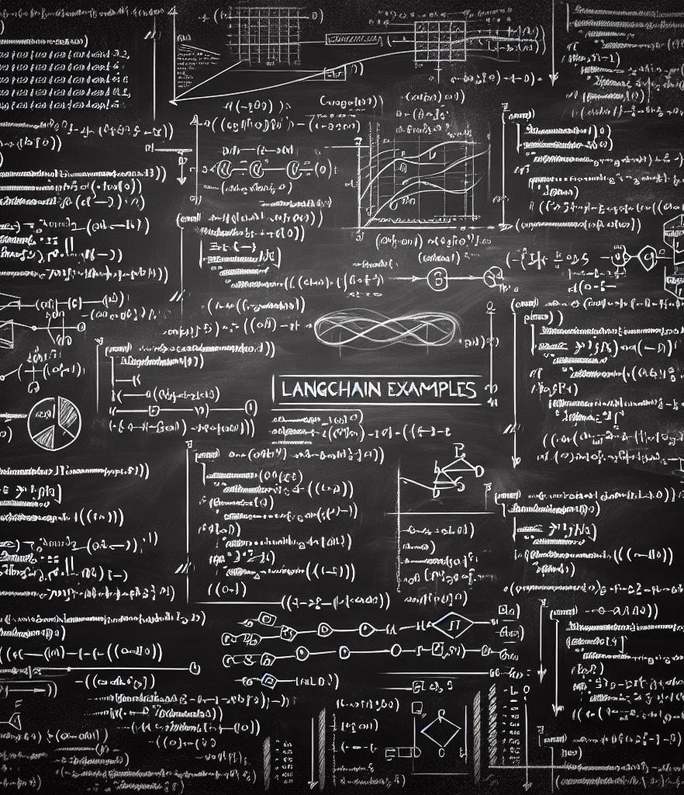
Examples
<3>

Slide 23
Chain example
Chains are an abstraction of a fixed workflow, taking some input, feeding it to an LLM and processing the output
LangChain introduces an expression language (LCEL) that allows elegant chain definition
See sample code: main_recipe_generator.py
model = ChatOpenAI()
prompt = ChatPromptTemplate.from_template("tell me a joke about {topic}")
chain = prompt | model
chain.invoke({"topic": "bears"})
chain = (
RunnablePassthrough()
| prompt_template
| model
| StrOutputParser()
)

Slide 24
Agent example
Program flow in a chain is fixed. An agent allows for adaptive flow
Agents require an overall goal, tools and an LLM
Idea: The agent reasons using an LLM how to reach a goal and which tools to use and dynamically generate actions
model = AzureChatOpenAI(temperature=0.2, azure_deployment=os.getenv("AZURE_GPT4_DEPLOYMENT"))
tools = [TavilySearchResults()]
agent = create_react_agent(llm=model, tools=tools, prompt=prompt)
agent_executor = AgentExecutor(agent=agent, tools=tools, verbose=True, handle_parsing_errors=True) agent_executor.invoke({
"period": "June",
"destination": "Thailand",
"type": "scuba diving"
})

Slide 25
LangGraph example
See langgraph.ipynb
Code is published here: https://github.com/ps78/langchain_starter

Slide 26
Conclusions
You don’t need LangChain to build LLM applications, but it makes everything a lot easier!
LangChain allows to focus on the core application logic, takes away a lot of boiler plate code
It’s easy to learn, documentation and tutorial are very good
But: the library evolves quickly, APIs change regularly. Be prepared for frequent updates of your code

Slide 27
Questions? Pascal Simon https://github.com/ps78

Slide 28

Setting everything up
<appendix>

Slide 29
Create an environment, install langchain
Create and activate virtual environment
conda create –-name langchain_starter
conda activate langchain_starter
Install langchain (will install compatible Python version as well)
pip install langchain langchain-openai python-dotenv
Optionally
pip install langchain-experimental
Additional packages depending on the tools you want, e.g.
pip install wolframalpha

Slide 30
Store your secrets
Most modules can read secrets and other configuration from the OS environment
Can use python-dotenv module to load these from a local .env text file
E.g.:
Load with
from dotenv import load_dotenv
load_dotenv()
BEARLY_API_KEY=“…"
WOLFRAM_ALPHA_APPID =“…"
AZURE_OPENAI_API_KEY=“…"
AZURE_OPENAI_ENDPOINT="https://mydeployment.openai.azure.com/"
AZURE_EMBEDDING_DEPLOYMENT="ADA2"
OPENAI_API_VERSION="2024-10-01-preview"
AZURE_GPT_DEPLOYMENT="GPT4"

Slide 31
Using Azure OpenAI
Azure provides OpenAI’s GPT models
Go to portal.azure, section Azure Open AI (only accessible from company network if you use your VS subscription)
Create resource group (CH-north works)
You will initialize need to fill out request form, usually approved withing 24 hours
Deploy the models you want
Store the deployment names, deployment URL and the API key in your .env file

